Slide 1
GE 1212: EMERGENCE OF BANGLADESH
Language Movement of 1948 and 1952

Slide 2
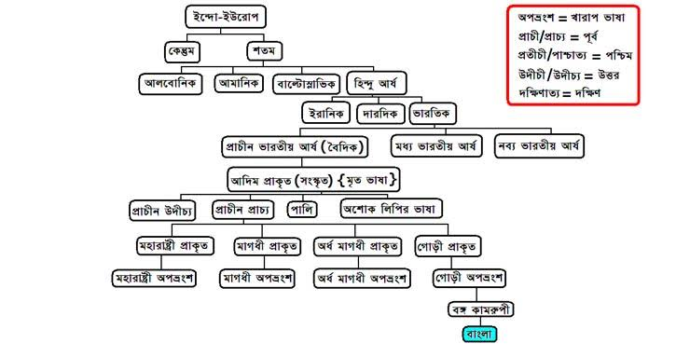

Slide 3
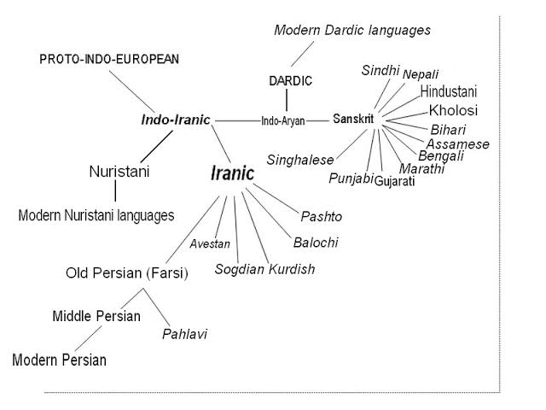

Slide 4
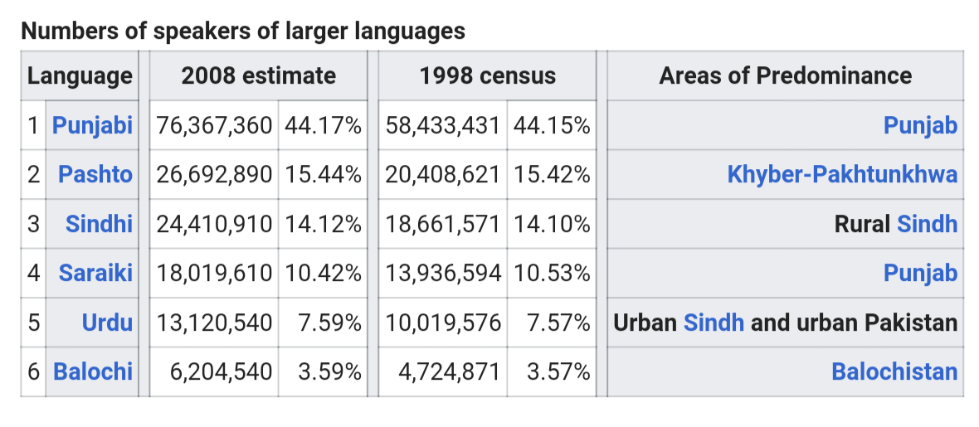

Slide 5
The Lingual State of Pakistan
Urdu is an Indo-Aryan language of the Indo-Iranian branch, belonging to the Indo-European family of languages. It developed under Persian, Arabic and Turkic influence on apabhramshas (last linguistic stage of the medieval Indian Aryan language Pali-Prakrit) in South Asia during the Delhi Sultanate and Mughal Empire. With its Perso-Arabic script, the language was considered a vital element of the Islamic culture for Indian Muslims; Hindi and the Devanagari script were seen as fundamentals of Hindu culture.
From the mid-19th century, the Urdu language had been promoted as the lingua franca of Indian Muslims by political and religious leaders, such as Sir Khwaja Salimullah, Sir Syed Ahmed Khan, Nawab Viqar-ul-Mulk and Maulvi Abdul Haq.

Slide 6
Bengali is an Eastern Indo-Aryan language that arose from the eastern Middle Indic languages around 1000 CE and developed considerably during the Bengal Renaissance.
While the use of Urdu grew common with Muslims in northern India, the Muslims of Bengal primarily used the Bengali language.
Supporters of Bengali opposed Urdu even before the partition of India, when delegates from Bengal rejected the idea of making Urdu the lingua franca of Muslim India in the 1937 Lucknow session of the Muslim League.

Slide 7
Early Phases
The Dominion of Pakistan's government, civil services, and military, however, were dominated by personnel from the western wing of the Dominion of Pakistan.
In 1947, a key resolution at a national education summit in Karachi advocated Urdu as the sole state language, and its exclusive use in the media and in schools.
Opposition and protests immediately arose. Students from Dhaka rallied under the leadership of Abul Kashem, the secretary of Tamaddun Majlish, a Bengali Islamic cultural organisation. The meeting stipulated Bengali as an official language of the Dominion of Pakistan and as a medium of education in East Bengal.
However, the Pakistan Public Service Commission removed Bengali from the list of approved subjects, as well as from currency notes and stamps. The central education minister Fazlur Rahman made extensive preparations to make Urdu the only state language of the Dominion of Pakistan.
Public outrage spread, and many Bengali students met on the University of Dhaka campus on 8 December 1947 to formally demand that Bengali be made an official language. To promote their cause, Bengali students organised processions and rallies in Dhaka.

Slide 8
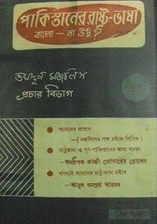

Slide 9
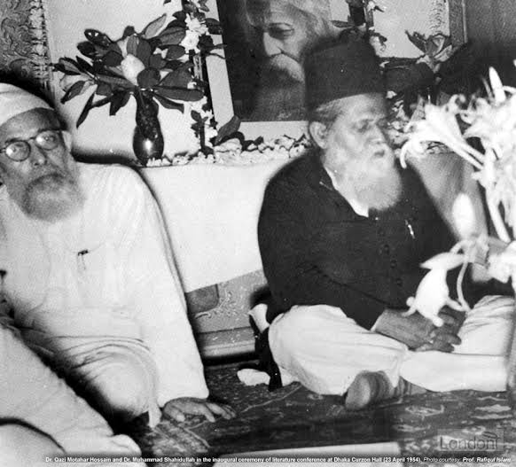
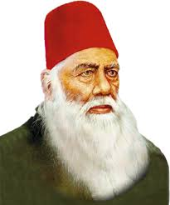
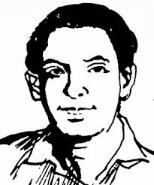

Slide 10
Initial Reaction
Leading Bengali scholars argued why Urdu should not be the only state language. The writer Abul Mansur Ahmed said if Urdu became the state language, the educated society of East Bengal would become 'illiterate' and 'ineligible' for government positions.
Assembly member Dhirendranath Datta proposed legislation in the Constituent Assembly of Pakistan to allow members to speak in Bengali and authorise its use for official purposes. Datta's proposal was supported by legislators Prem Hari Burman, Bhupendra Kumar Datta and Sris Chandra Chattaopadhyaya of East Bengal, as well as the people from the region.
Prime minister Liaquat Ali Khan and the Muslim League denounced the proposal as an attempt to divide the Pakistani people, thus the legislation was defeated.

Slide 11
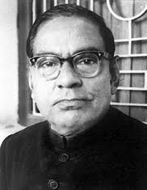
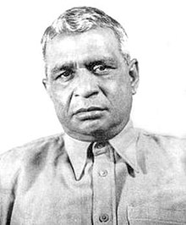

Slide 12
Formation of Committees
The first Rastrabhasa Sangram Parishad (National Language Action Committee), an organisation in favour of Bengali as a state language was formed towards the end of December 1947. Professor Nurul Huq Bhuiyan of the Tamaddun Majlish convened the committee.
Later, Parliament member Shamsul Huq convened a new committee to push for Bengali as a state language.
On 31 January, 1952 the Shorbodolio Kendrio Rashtrobhasha Kormi Porishod (All-Party Central Language Action Committee) was formed in a meeting at the Bar Library Hall of the University of Dhaka, chaired by Maulana Bhashani.

Slide 13
Agitations of 1948
Students of the University of Dhaka and other colleges of the city organised a general strike on 11 March 1948 to protest the omission of Bengali language from official use, including coins, stamps and recruitment tests for the navy.
The movement restated the demand that Bengali be declared an official language of the Dominion of Pakistan. Political leaders such as Shamsul Huq, Sheikh Mujibur Rahman, Shawkat Ali, M Sirajul Islam, Kazi Golam Mahboob, Oli Ahad, Abdul Wahed and others were arrested during the rallies.

Slide 14
In the afternoon of 11 March, a meeting was held to protest police brutality and arrests. A group of students marching towards the chief minister Khawaja Nazimuddin's house was stopped in front of the Dhaka High Court.
The rally changed its direction and moved in the direction of the Secretariat building. Police attacked the procession injuring several students and leaders, including A. K. Fazlul Huq. Continuing strikes were observed the following four days.
Under such circumstances, the chief minister Nazimuddin signed an accord with the student leaders agreeing to some terms and conditions, without complying to the demand that Bengali be made a state language.

Slide 15
Jinnah’s Arrival and………
In the height of civic unrest, Governor-General of Pakistan Muhammad Ali Jinnah arrived in Dhaka on 19 March 1948.
On 21 March, at a civic reception at Racecourse Ground, he claimed that the language issue was designed by a "fifth column" to divide Pakistani Muslims. Jinnah further declared that "Urdu, and only Urdu" embodied the spirit of Muslim nations and would remain as the state language, labelling those who disagreed with his views as "Enemies of Pakistan".
Jinnah delivered a similar speech at Curzon Hall of the University of Dhaka on 24 March. At both meetings, Jinnah was interrupted by large segments of the audience.
He later called a meeting of a state language committee of action, and overruled the contract that was signed by Khawaja Nazimuddin with the student leaders. Before Jinnah left Dhaka on 28 March, he delivered a speech on radio reasserting his "Urdu-only" policy.
Shortly thereafter, the East Bengal Language Committee, presided by Maulana Akram Khan, was formed by the East Bengal government to prepare a report on the language problem. The Committee completed its report on 6 December 1950, but it was not published until 1958. The government suggested that Bengali be written in Arabic script, as a potential solution to the language conflict.

Slide 16
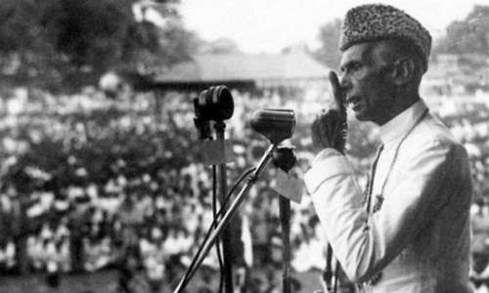

Slide 17
Events of 1952
26th January- The Basic Principles Committee of the Constituent Assembly
The Urdu-Bengali controversy was reignited when Jinnah's successor, governor-general Khawaja Nazimuddin, staunchly defended the "Urdu-only" policy in a speech on 27 January 1952.
30 January- RSP called nationwide student strike and mass meeting
On 31 January, the Shorbodolio Kendrio Rashtrobhasha Kormi Porishod(All-Party Central Language Action Committee) was formed in a meeting at the Bar Library Hall of the University of Dhaka, chaired by Maulana Bhashani.
The central government's proposal of writing the Bengali language in Arabic script was vehemently opposed at the meeting.
The action committee called for an all out protest on 21 February, including strikes and rallies. In an attempt to prevent the demonstration, the government imposed Section 144 in Dhaka, thereby banning any gathering

Slide 18
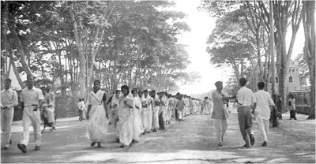
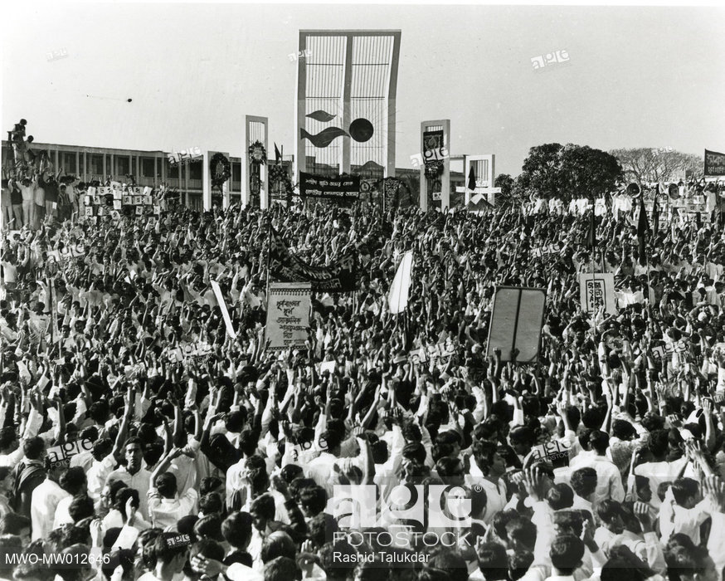
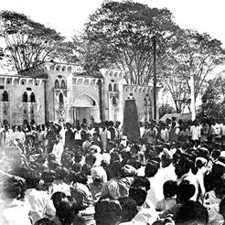

Slide 19
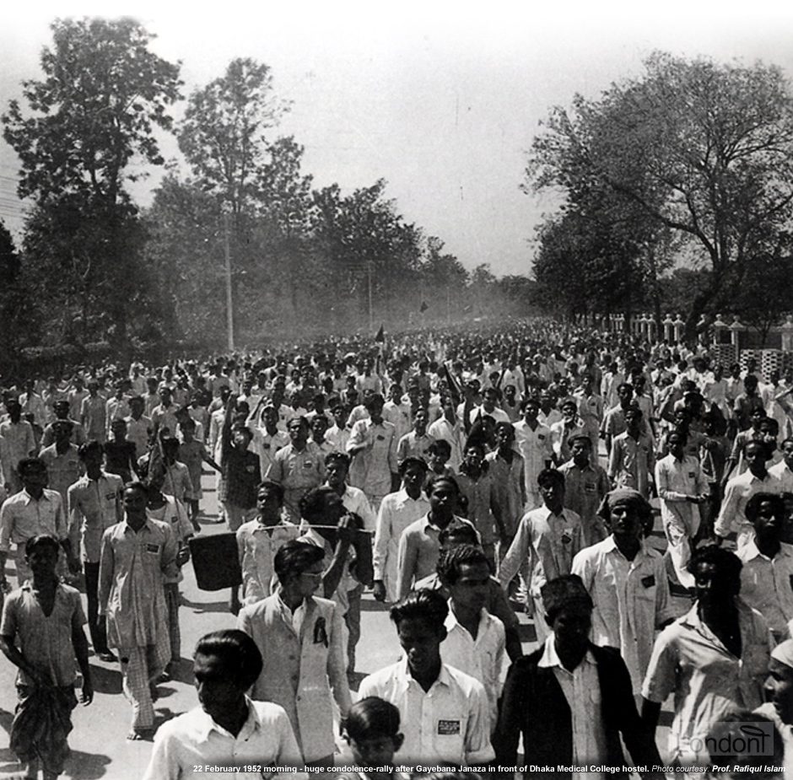
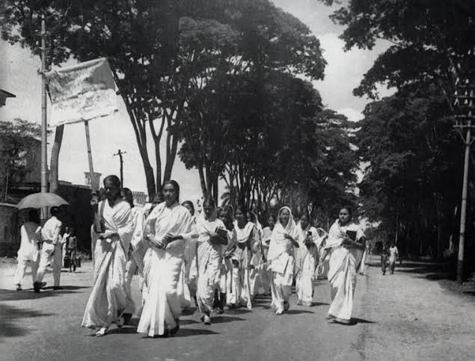

Slide 20
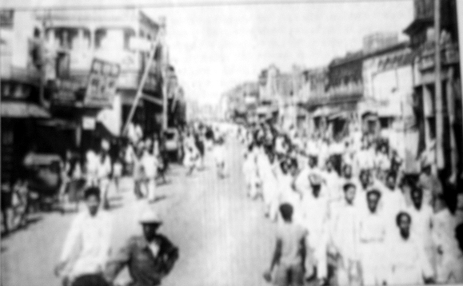
4th February- Massive protests observed throughout the country
20 th Feruary-144 section for One Month
20th February

Slide 21
21st February
At nine o'clock in the morning, students began gathering on the University of Dhaka premises in defiance of Section 144..
By a quarter past eleven, students gathered at the university gate and attempted to break the police line. Police fired tear gas shells towards the gate to warn the students. A section of students ran into the Dhaka Medical College while others rallied towards the university premises cordoned by the police.
The vice-chancellor asked police to stop firing and ordered the students to leave the area. However, the police arrested several students for violating section 144 as they attempted to leave. Enraged by the arrests, the students met around the East Bengal Legislative Assembly and blocked the legislators' way, asking them to present their insistence at the assembly.
When a group of students sought to storm into the building, police opened fire and killed a number of students, including Abdus Salam, Rafiq Uddin Ahmed, Abul Barkat and Abdul Jabbar. As the news of the killings spread, disorder erupted across the city. Shops, offices and public transport were shut down and a general strike began.
At the assembly, six legislators including Manoranjan Dhar, Boshontokumar Das, Shamsuddin Ahmed and Dhirendranath Datta requested that chief minister Nurul Amin visit wounded students in hospital and that the assembly be adjourned as a sign of mourning. This motion was supported by some treasury bench members including Maulana Abdur Rashid Tarkabagish, Shorfuddin Ahmed, Shamsuddin Ahmed Khondokar and Mosihuddin Ahmed. However, Nurul Amin refused the requests.

Slide 22
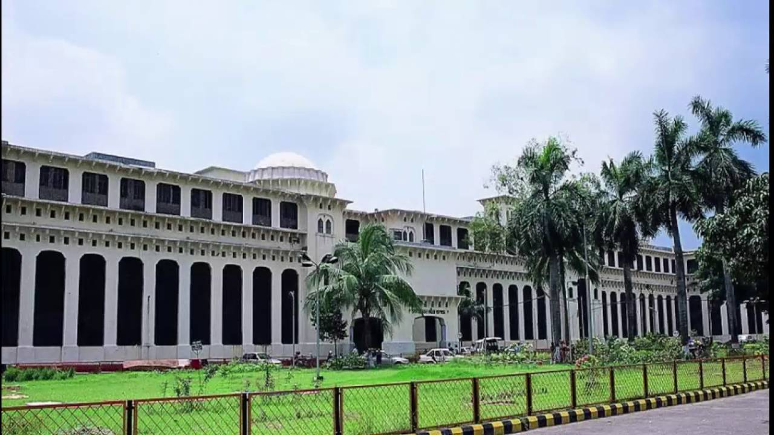

Slide 23
22 February
Disorder spread across the province as large processions ignored section 144 and condemned the actions of the police. More than 30,000 people congregated at Curzon Hall in Dhaka.
During the continued protests, police actions led to the death of four more people. This prompted officers and clerks from different organisations, including colleges, banks and the radio station, to boycott offices and join the procession.
Protesters burned the offices of two leading pro-government news agencies, the Jubilee Press and the Morning News.
Police fired on a major janaza as it was passing. The shooting killed several people including activist Sofiur Rahman and a nine-year-old boy named Ohiullah.

Slide 24
Continued Unrest
Through the night of 23 February, students of Dhaka Medical College worked on the construction of a Shaheed Smritistombho, or Monument of Martyrs. Completed at dawn on 24 February, the monument had a handwritten note attached to it with the words "Shaheed Smritistombho". Inaugurated by the father of the slain activist Sofiur Rahman, the monument was destroyed on 26 February by police.
On 25 February, industrial workers in the town of Narayanganj observed a general strike.
A protest followed on 29 February whose participants faced severe police beating.
The government censored news reports and withheld exact casualty figures during the protests. Most pro-government media held Hindus and communists responsible for encouraging the disorder and student unrest.
The families of Abul Barkat and Rafiq Uddin Ahmed tried to charge the police with murder, but the charges were dismissed by the police. On 8 April government report on the incidents failed to show any particular justification for police firings on the students. When the constituent assembly reconvened on 14 April, proceedings were stalled by members of the Muslim League when legislators from East Bengal sought to raise the language issue

Slide 25
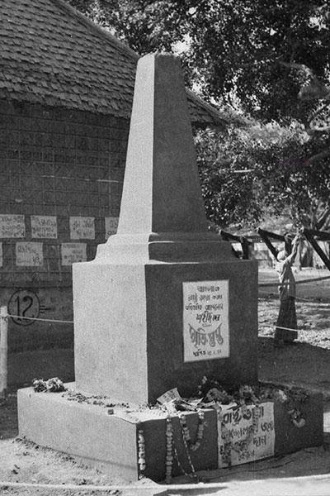
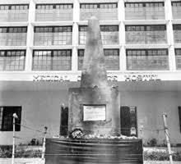

Slide 26
Events after 1952
The Shorbodolio Kendrio Rashtrobhasha Kormi Porishod, with support from the Awami Muslim League, decided to commemorate 21 February as Shohid Dibosh .
On the first anniversary of the protests, people across East Bengal wore black badges in solidarity with the victims. Most offices, banks and educational institutions were closed to observe the occasion. Student groups made agreements with college and police officials to preserve law and order.
More than 100,000 people assembled at a public meeting held in Dhaka, where community leaders called for the immediate release of Maulana Bhashani and other political prisoners.
However, West Pakistani politicians such as Fazlur Rahman aggravated sectional tensions by declaring that anyone who wanted Bengali to become an official language would be considered an "enemy of the state".
Bengali students and civilians disobeyed the restrictions to celebrate the anniversary of the protests. Demonstrations broke out on the night of 21 February 1954 with various halls of the University of Dhaka raising black flags in mourning.

Slide 27
United Front in 1954
Political tensions came to a head as elections to the provincial assembly of East Bengal were held in 1954. The ruling Muslim League denounced the opposition United Front coalition, which—led by A. K. Fazlul Huq and the Awami League—wanted greater provincial autonomy. Several United Front leaders and activists were arrested. A meeting of parliament's Muslim League members, chaired by prime minister Muhammad Ali Bogra, resolved to give official recognition to Bengali. This decision was followed by a major wave of unrest as other ethnic groups sought recognition of other regional languages.
Proponents of Urdu such as Maulvi Abdul Haq condemned any proposal to grant official status to Bengali. He led a rally of 100,000 people to protest against the Muslim League's decision.
Consequently, the implementation failed and the United Front won a vast majority of seats in the legislative assembly, while the representation of the Muslim League was reduced to a historic low.
The United Front ministry ordered the creation of the Bangla Academy to promote, develop, and preserve Bengali language, literature, and heritage. However, the United Front rule was temporary, as Governor General Ghulam Muhammad cancelled the government and started Governor's rule on 30 May 1954. The United Front again formed the ministry on 6 June 1955 after the governor's regime ended. The Awami League did not participate in this ministry though.
Following the return of the United Front to power, the anniversary on 21 February 1956 was observed for the first time in a peaceful atmosphere.
The Government supported a major project to construct a new Shaheed Minar.
The session of the constituent assembly was stopped for five minutes to express condolence for the students slain in the police shootings. Major rallies were organised by Bengali leaders and all public offices and businesses remained closed.

Slide 28
Constitutional reform
On 7 May 1954, the constituent assembly resolved, with the Muslim League's support, to grant official status to Bengali. Bengali was recognised as the second official language of Pakistan on 29 February 1956, and article 214(1) of the constitution of Pakistan was reworded to "The state language of Pakistan shall be Urdu and Bengali." However, the military government formed by Ayub Khan made attempts to re-establish Urdu as the sole national language. On 6 January 1959, the military regime issued an official statement and reinstated the official stance of supporting the 1956 constitution's policy of two state languages.

Slide 29
Legacy and Outcome
The Language Movement had a major cultural impact on Bengali society. It has inspired the development and celebration of the Bengali language, literature and culture.
21 February, celebrated as Language Movement Day or Shohid Dibosh (Martyrs' Day), is a major national holiday in Bangladesh.
A month-long event called the Ekushey Book Fair is held every year to commemorate the movement.
Ekushey Padak, one of the highest civilian awards in Bangladesh, is awarded annually in memory of the sacrifices of the movement.
Songs such as Abdul Gaffar Choudhury's Ekusher Gaan, set to music by Shaheed Altaf Mahmud, as well as plays, works of art and poetry played a considerable role in rousing the people's emotions during the movement.
Since the events of February 1952, poems, songs, novels, plays, films, cartoons and paintings were created to capture the movement from varied point of views.
Notable artistic depictions include the poems Bornomala, Amar Dukhini Bornomala and February 1969 by Shamsur Rahman, the film Jibon Theke Neya by Zahir Raihan, the stage play Kobor by Munier Chowdhury and the novels Ekushey February by Raihan and Artonaad by Shawkat Osman.

Slide 30
Two years after the first monument was destroyed by the police, a new Shaheed Minar (Monument of Martyrs) was constructed in 1954 to commemorate the protesters who lost their lives. Work on a larger monument designed by the architect Hamidur Rahman began in 1957 with the support of the United Front ministry. Hamidur Rahman's model consisted of a large complex in the yard of the Dhaka Medical College Hostel. The design included a half-circular column symbolizing a mother with her martyred sons standing at the dais in the centre of the monument.
Although the imposition of martial law in 1958 interrupted the work, the monument was completed and inaugurated on 21 February 1963 by Abul Barkat's mother, Hasina Begum.
Pakistani forces demolished the monument during the Bangladesh Liberation War of 1971, but the Bangladeshi government reconstructed it in 1973.
Ekushey Television, the first private terrestrial TV channel of Bangladesh was named after the Event of 21 February

Slide 31

UNESCO Recognition
Worldwide
Bangladesh officially sent a proposal to UNESCO to declare 21 February as International Mother Language Day. The proposal was supported unanimously at the 30th General Conference of UNESCO held on 17 November 1999.

